Slide 1
GNSSRO data assimilation using JEDI SkyLab on AWS
Hailing Zhang
COSMIC Program Office/Joint Center for Satellite Data Assimilation
University Corporation for Atmospheric Research
Acknowledgment
Lindsey Hayden and Hannah Huelsing
for their help on this workshop
JCSDA JEDI core team and OBS team for the base AMI and their support on JEDI SkyLab
COSMIC ACCESS workshop, Boulder, CO, 17 August 2023

Slide 2


Outline
(Brief) Introduction to JEDI SkyLab
Instance setup/Login
SkyLab and ecflow
SkyLab experiment hands-on
Plotting and Diagnosing

Slide 3
Introduction: JEDI UFO
JEDI (Joint Effort for Data assimilation Integration)
a joint effort based on Agile approach by integrating continuously small code increments, which enables all developers to see and review the code as quickly as it is being developed
developers use github/zenhub to create and discuss issues, identify bugs, make improvements, and commit code changes and make pull request to develop branch.
JEDI UFO (Unified Forward Operator)
introduces standard interfaces between the model and observation worlds
observation operators are model-agnostic and can easily be shared, exchanged, and compared
model-specific interfaces: fv3-jedi, mpas-jedi,…
GNSS RO UFO (global navigation satellite system radio occultation)
provides multiple GNSS RO operators;
includes flexible configurations for operator, QC, observation error, and many other important parameters in data assimilation;
calls abstract “observation filters” before and after the actual observation operator
facilitates comparison and application of multiple operators in the same framework.

Slide 4
Introduction: GNSSRO UFO - (flexible) Configurable
 |  | option1 | option2 | option3 | option4
operator | Bending angle | BndNBAM | BndROPP1D | BndROPP2D | BendMetOffice
 | refractivity | RefNCEP | RefMetOffice
quality control | Background departure | Generic | RONBAM
 | Super refraction | NBAM | ECMWF | CDAAC observation-based (to be added)
 | Profile QC | LSW | 1DVar
Observation error | In obs file | NBAM | NRL | ECMWF | Read in from file
Observation filter | Mission id/ gnss id | Height/lat | rising/setting | Processing_center | and more

Slide 5
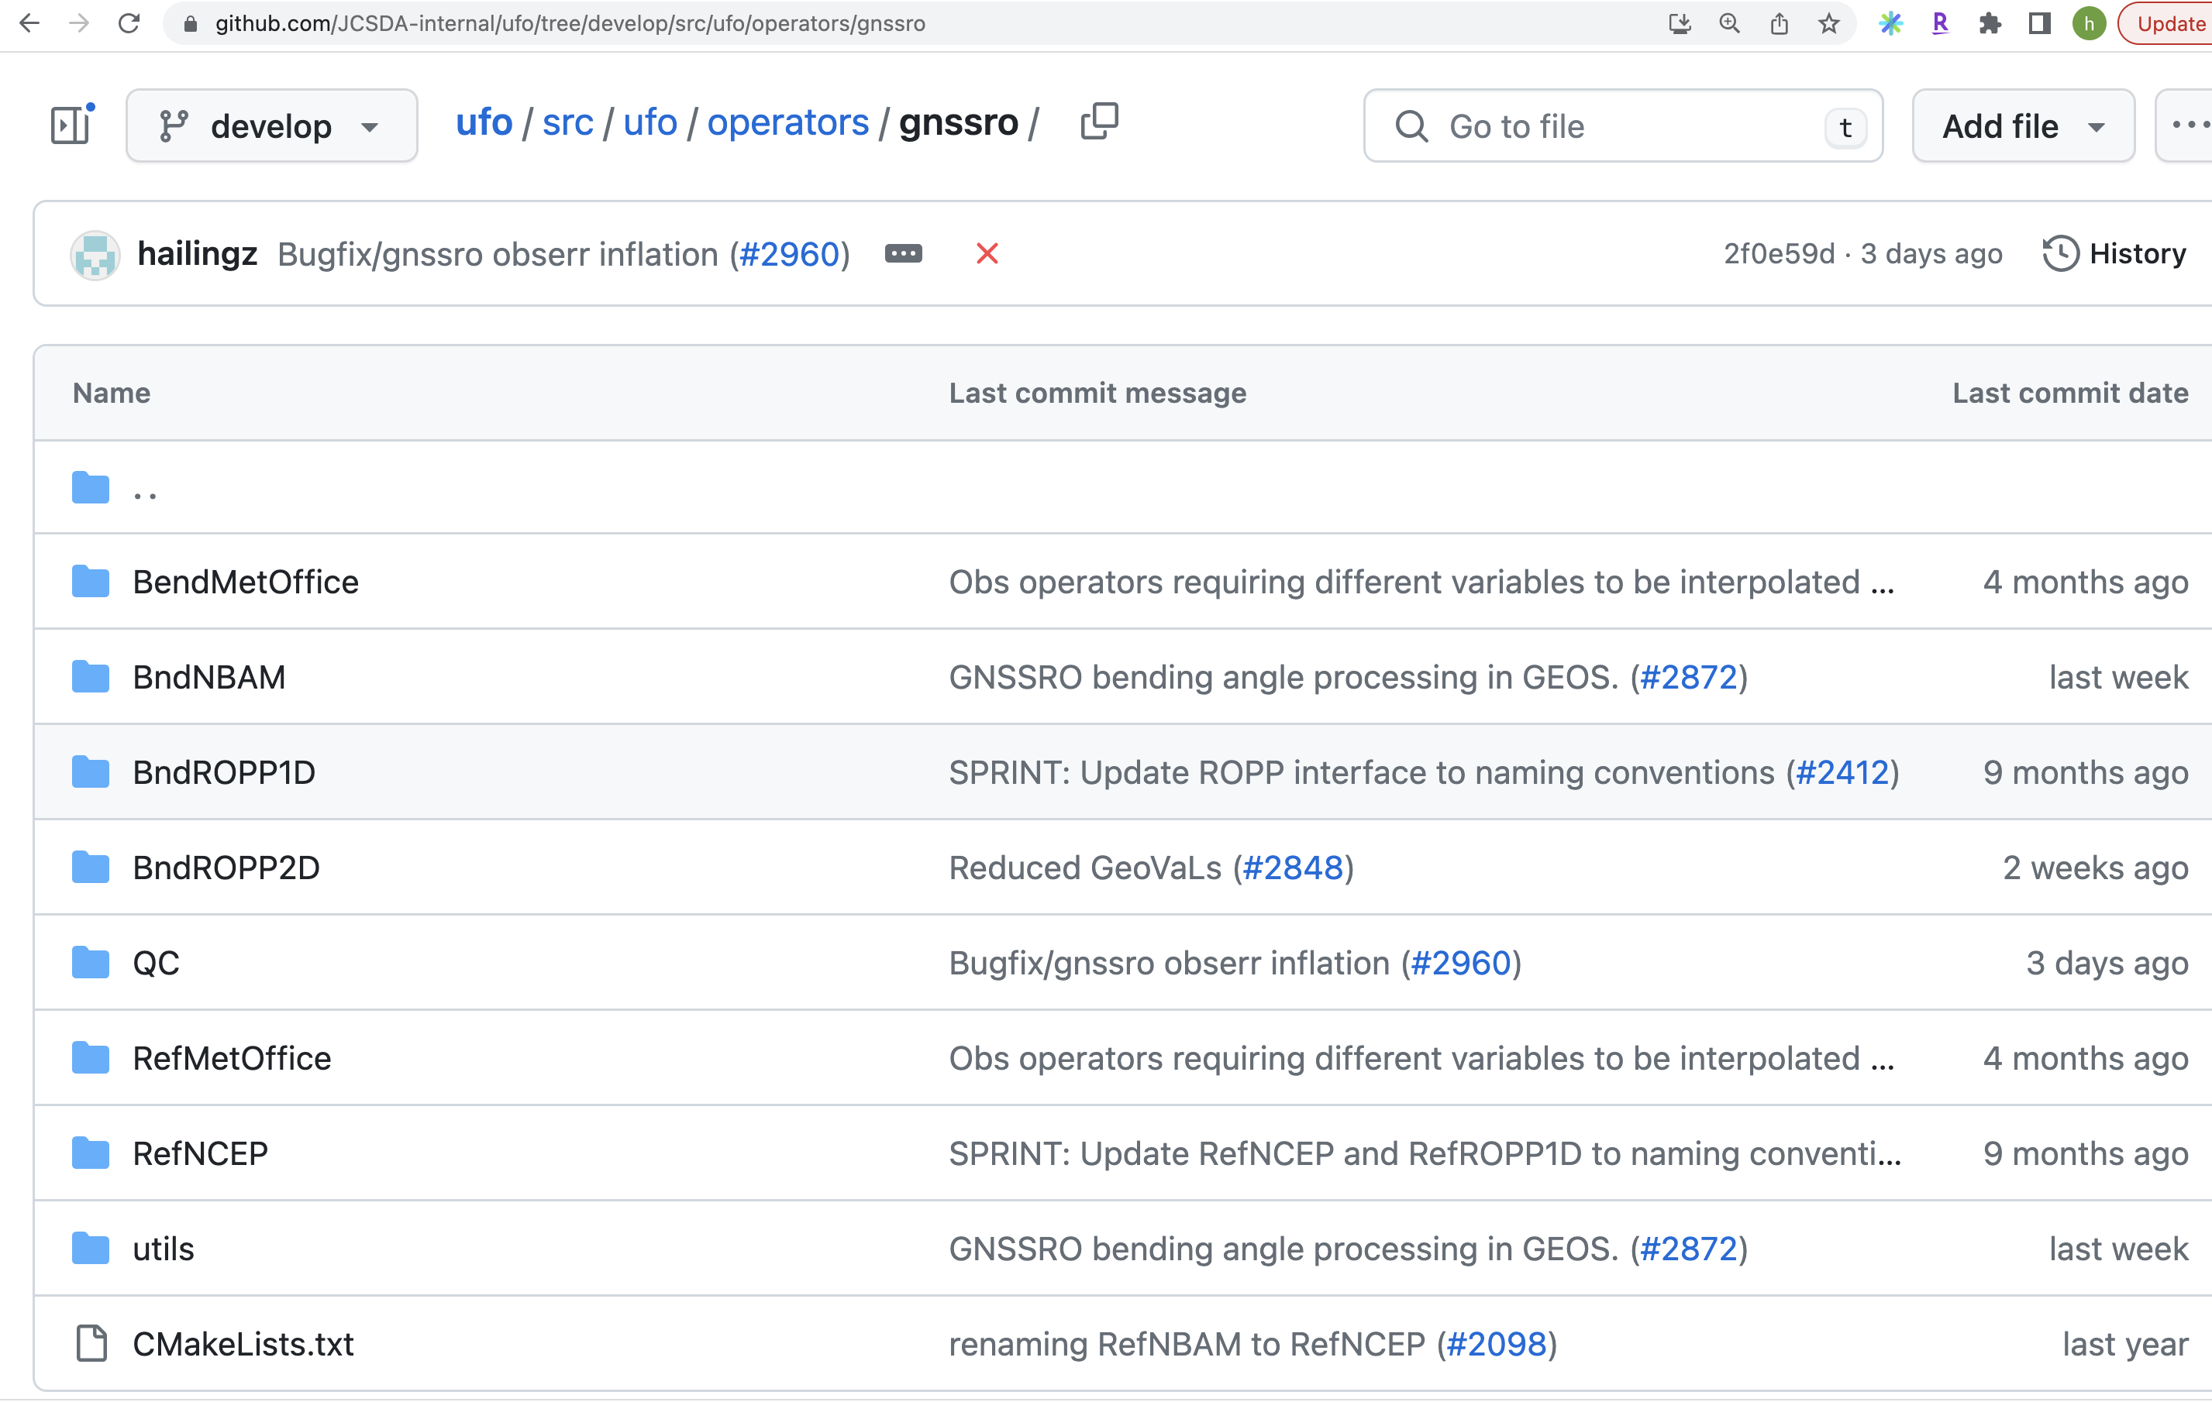
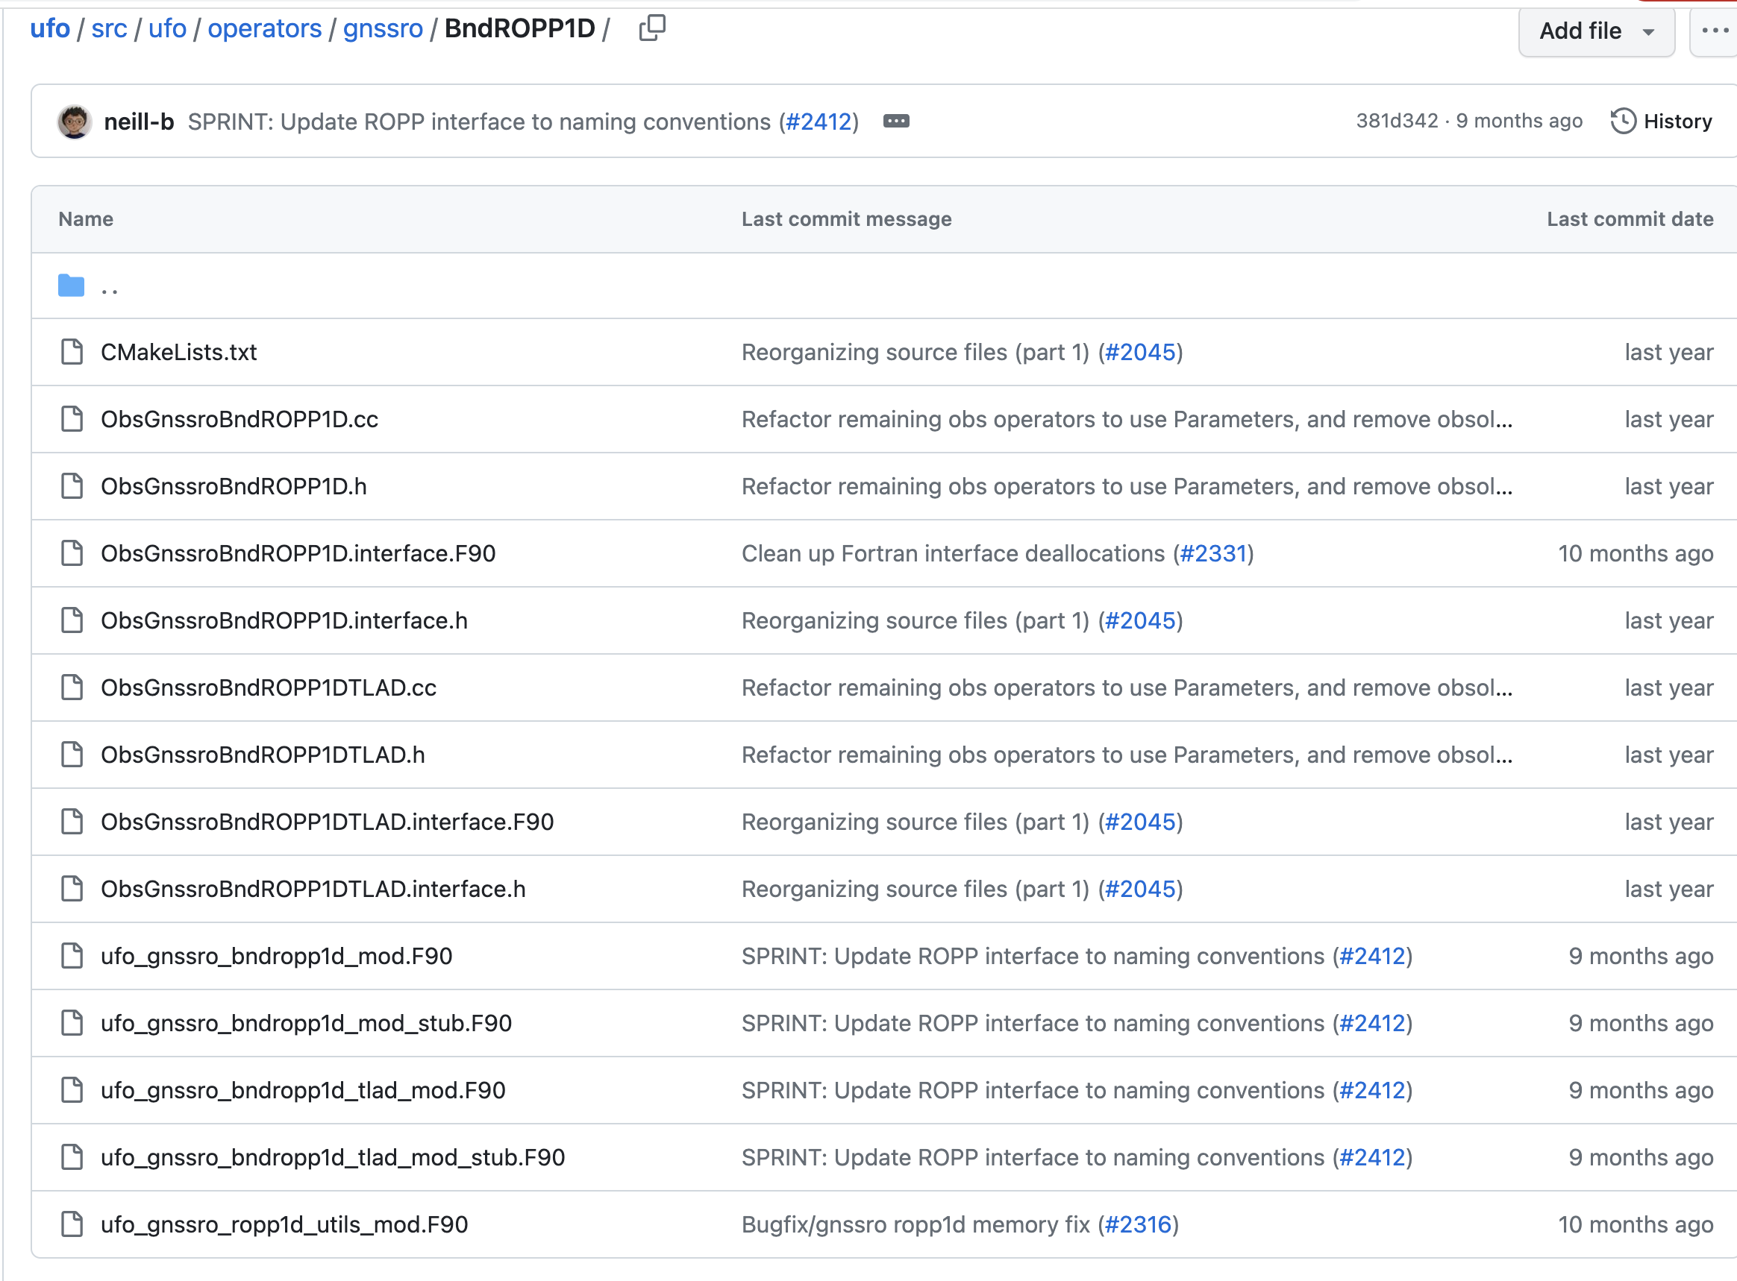
New GNSS operators?

Slide 6
Introduction: observation handling and conversion
IODA (Interface for Observation Data Access )
provides functionality for I/O of observation data and in-memory access.
IODA converters
convert observations from various sources to the IODA observation files.
multiple converters for a given observation type, contributed by multiple members and partners.
GNSS RO ioda-converters
Multiple data feed
WMO/CDAAC individual bufr files
NCEP GDAS bufr file
GSI diag file
AWS individual files
Various languages: Fortran, Python, yaml-based.

Slide 7
Introduction: JEDI-SkyLab?
JEDI promotes ease in implementation of multiple options for simulating observations. YAML controls experiment set-up (data usage, solver, channel selection, quality control, observation error, etc).
JEDI-SkyLab 5.0 is the fifth roll-up release
provides integrated Earth System Data Assimilation capability via a unified end-to-end ecosystem including a single code build, workflow, data store, and diagnostics dashboard.
Initial capabilities are demonstrated for the following components: atmosphere, ocean, sea-ice, soil moisture, snow, aerosols, and composition.
https://www.jcsda.org/jediskylab

Slide 8
How to run JEDI-SkyLab (in one day)?
Computing: AWS instance c6i.16xlarge
Preloaded image: Amazon Machine Image (AMI)
Modules/Libraries (spack-stack, provided and maintained by JEDI infra team)
compiled executables (and source FV3-JEDI codes)
Installed workflow - ecflow
local r2d2 database (pre-stored data)
Benchmark experiment “ctrl”
A number of configuration “yaml” files
Plotting scripts
JEDI-SkyLab 5.0 is the fifth roll-up release that provides integrated Earth System Data Assimilation capability via a unified end-to-end ecosystem including a single code build, workflow, data store, and diagnostics dashboard.

Slide 9
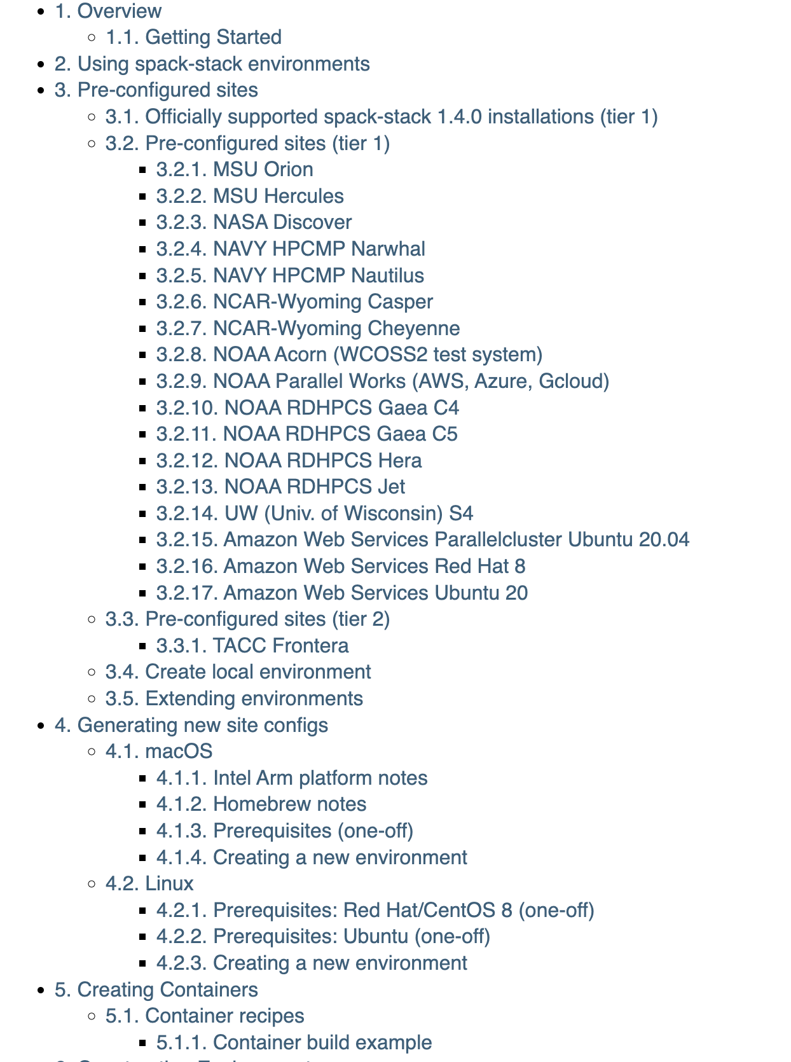
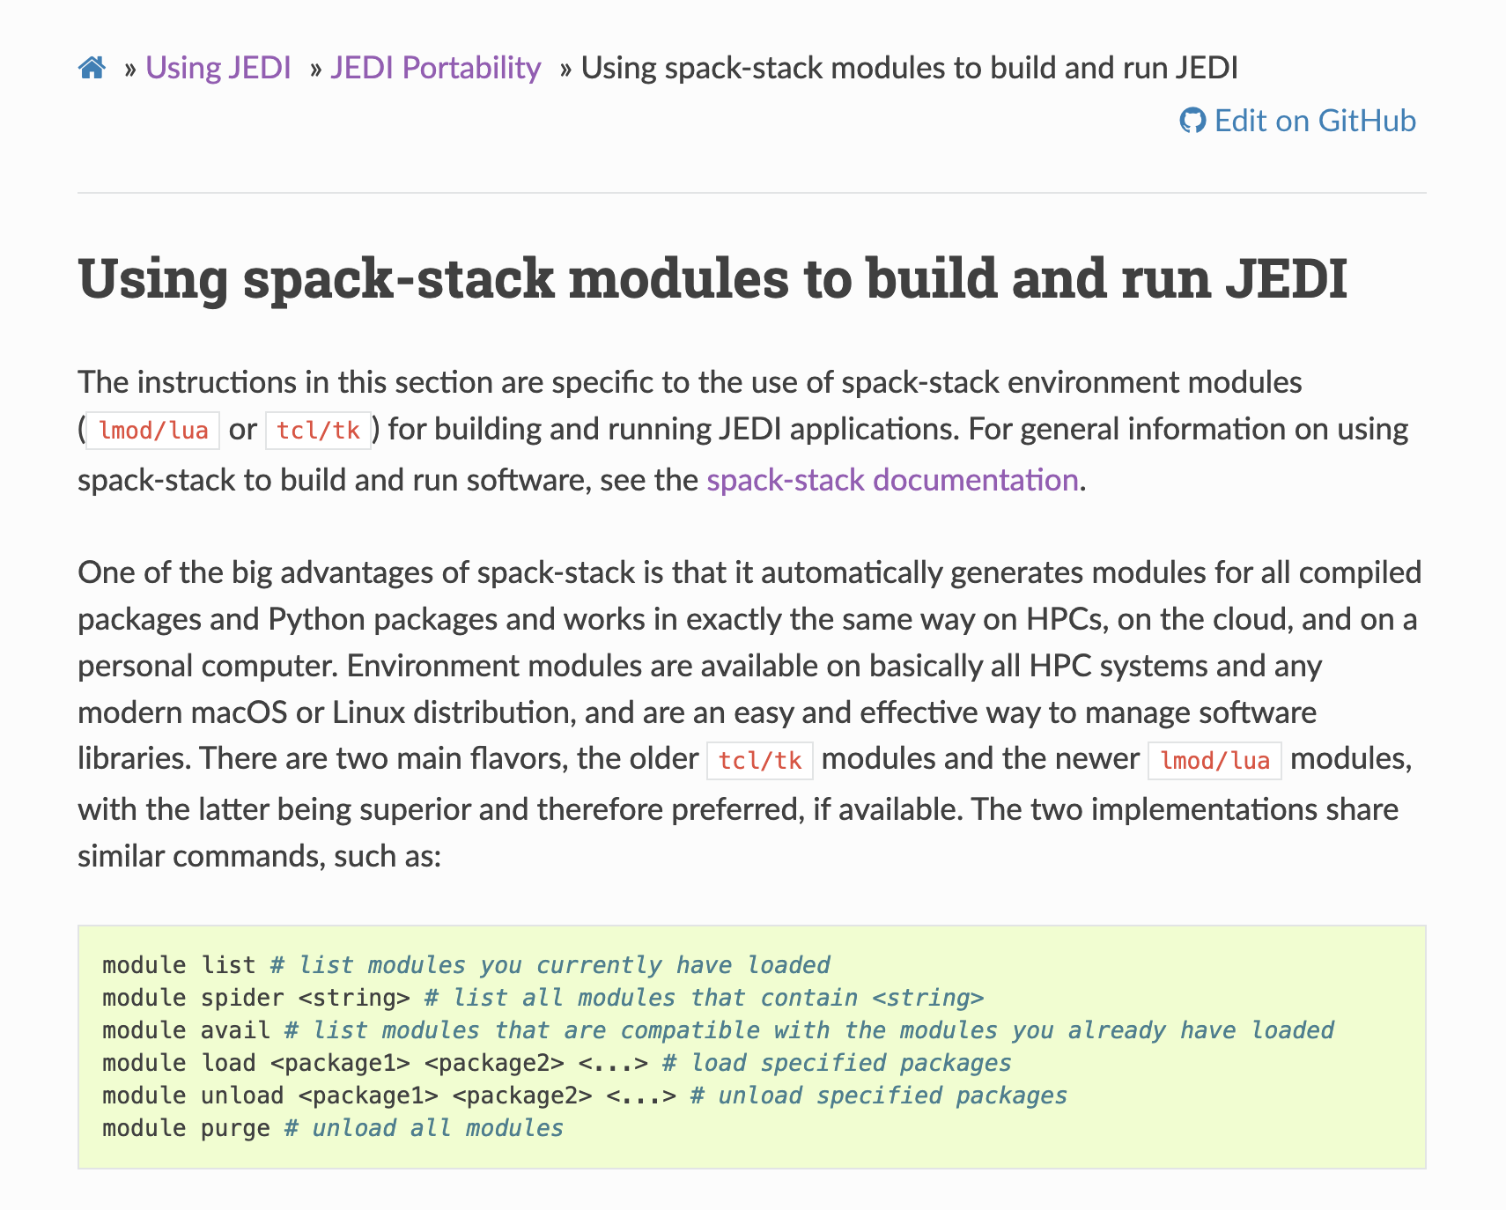
Spack-stack
https://spack-stack.readthedocs.io/en/1.4.0/
https://jointcenterforsatellitedataassimilation-jedi-docs.readthedocs-hosted.com/en/latest/using/jedi_environment/modules.html

Slide 10
GNSSRO data impact study
JEDI-SkyLab
FV3-JEDI: Finite­-Volume Cubed-Sphere Dynamical Core
Resolution: c96 (~1 degree horizontally)
Test period: August 1-2, 2021
Radiosonde, GNSSRO, and radiance observations
Configurations
Background departure quality control (OMB QC)
Satellite/mission denial
COSMIC-2 data denial
UCAR/ROMSAF processed RO data
Analyzing and plotting

Slide 11
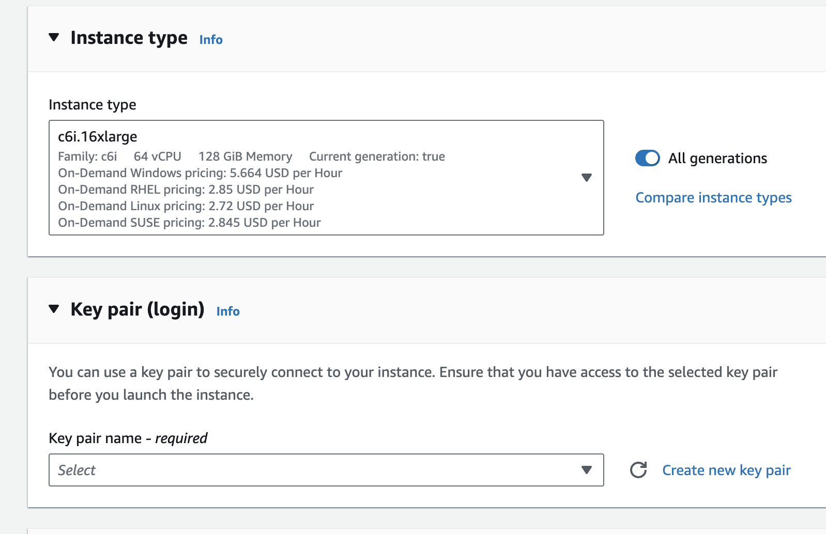
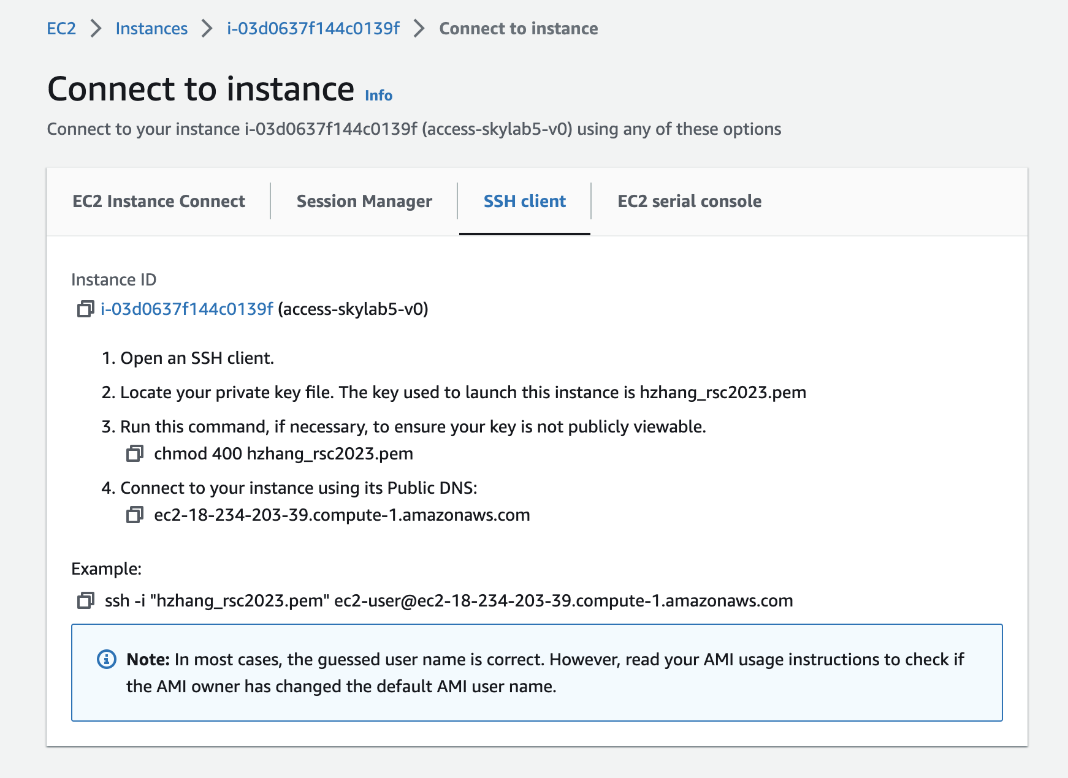
Instance setup
Name: your choice
Instance type: c6i.16xlarge
AMI: skylab5_access_demo
Key pair (.pem)
choose existing one
or create new key pair (click and it will be saved to your default download directory)
Security group: see AWS intro presentation

Slide 12
Log in
Check your email from nasa_access_gnssro@aer.com "for JEDI lab”
Go to the directory where your “.pem” file is saved.

Slide 13
Log in
pwd
/home/ec2-user
ls
ecflow_server: ecflow run time files
Jedi: containing jedi related fix files, static only now
spack-stack: containing modules and libraries
r2d2-experiments-localhost: local database containing observations, model backgrounds, satellite bias correction files
setup_modules.sh: loading modules from spack-stack
setup_skylab.sh: setting up for skylab experiments.
work: the directory we will work in
source setup_modules.sh
you can "module list" and will see 124 modules loaded

Slide 14
Skylab and ecflow
vi setup_skylab.sh
work directories
StaticB directory
server port
virtual environment will be turned on
source setup_skylab.sh
Will be in a virtual environment. Your command prompt should start with "venv".
echo $ECF_PORT
result should be 2500, which is the port we run ecflow.
sudo /sbin/service mysqld start
to use the r2d2 database
https://github.com/JCSDA-internal/r2d2
ecflow_start.sh -p $ECF_PORT
will generate screen messages. Pay attention to the last three lines. You will see your "hostname" which is your instance's IP address.
ecflow_ui &
It takes 30 - 60 seconds to pop up an UI, the user interface window.
Once you see the UI window, click on the server icon from the menu on the top, click on the manage server and edit, check if the IP address is correct. Then close.
You may need to close the UI window and re-type "ecflow_UI" to reflect the change (this step needs to be done only once).

Slide 15
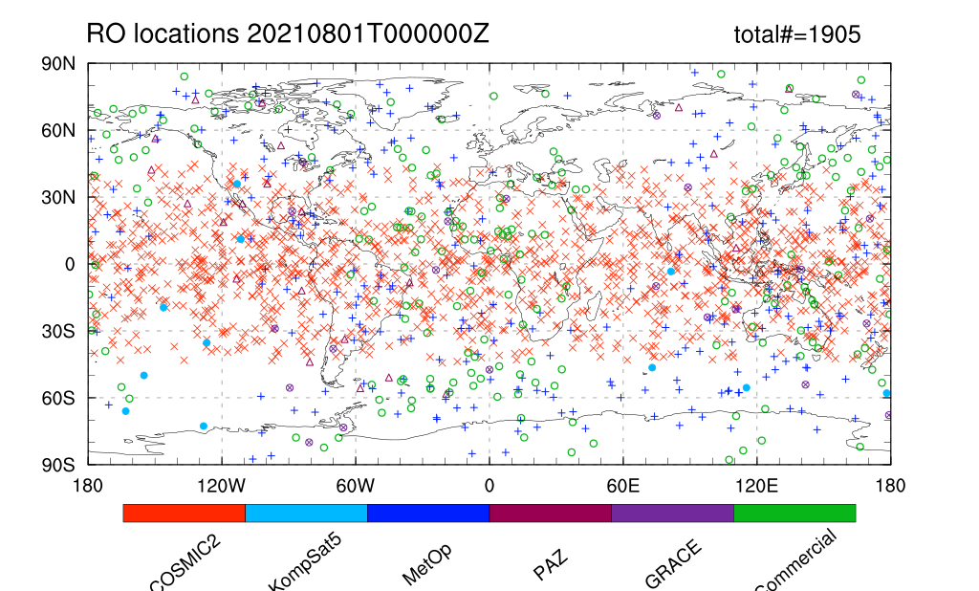
Skylab experiment 1
cd ${JEDI_SRC}/skylab/experiments/
create_experiment.py gfs-3dvar-c96-radiosonde_ro.yaml --test
--test is to avoid clean up
vi gfs-3dvar-c96-radiosonde_ro.yaml
init_cycle/last_cycle
geometry
OBSERVATIONS
Ninner
static_data
window_mode
MINIMIZER
ecflow/workdir
$JEDI_ROOT/workdir
$JEDI_ROOT/ecflow
Monitor experimental progress via ecflow_ui
cd ${JEDI_ROOT}/plots
usencl to use ncl;
quitncl to quit ncl
plot_gnssro_obs_location.ncl
This script shows the distributions of RO data by missions.
plot_fit2gnssro_omb_oma_ctrl.ncl and follow the instructions
This script shows the statistics in RO space, or, fitting-to-RO observation, or OMB/OMA.

Slide 16
Skylab experiment 2
cd ${JEDI_SRC}/skylab/experiments/
Conduct sensitivity experiments
adding amsua
gfs-3dvar-c96-ctrl.yaml
diff gfs-3dvar-c96-ctrl.yaml gfs-3dvar-c96-radiosonde_ro.yaml
use different RO QC
gfs-3dvar-c96-radiosonde_ro_qc.yaml
deny cosmic2 RO data
gfs-3dvar-c96-radiosonde_ro_noc2.yaml
Assimilate ascending profiles only
gfs-3dvar-c96-opendataregistry_ucar_ascending.yaml
create_experiment.py $your yaml --test
cd ${JEDI_ROOT}/plots
usencl to use ncl;
quitncl to quit ncl
plot_fit2gnssro_omb_ctrl_vs_your_exp.ncl
How does the new configuration impact the statistics in RO space?
plot_fit2radiosonde_temperature_omb_ctrl_vs_your_exp.ncl
How does the new configuration impact the statistics in radiosonde observations?

Slide 17
Skylab experiment 3
Use GNSS RO data from Open Data Registry
Install IODA converter
https://github.com/JCSDA/ioda-bundle
Run IODA converter
cd /home/ec2-user/work/JEDI_ROOT/openDataConverter
Wrapper script: grabData.sh
downloadData.py
gnssro_AWSopendataNetcdf2ioda.py
Conduct sensitivity experiments
Romsaf
gfs-3dvar-c96-opendataregistry_ucar_ascending.yaml
ucar
gfs-3dvar-c96-opendataregistry_ucar_ascending.yaml
Assimilate ascending profiles only
gfs-3dvar-c96-opendataregistry_ucar_ascending.yaml
create_experiment.py $your yaml --test

Slide 18
JEDI tutorials and demonstrations
Past Academies
https://www.jcsda.org/jedi-academies
Documentations
https://jointcenterforsatellitedataassimilation-jedi-docs.readthedocs-hosted.com/en/latest/overview/index.html
JEDI forum
https://forums.jcsda.org/
JEDI repositories
https://github.com/JCSDA
JEDI SkyLab demo
https://skylab.jcsda.org/
JEDI SkyLab release page
https://www.jcsda.org/jediskylab
spack-stack
https://spack-stack.readthedocs.io/en/1.4.0/
https://jointcenterforsatellitedataassimilation-jedi-docs.readthedocs-hosted.com/en/latest/using/jedi_environment/modules.html

